Slide 1


2019
PROJECT DATA ANALYST
TEST
By Muhammad Rizky Halawi

Slide 2

ABOUT THIS PROJECT
This project just to make analyze from the raw data
from Kadence :
1
Demograpic Profilling
2
Data Visualization 1
3
Data Visualization 2

Slide 3



Tools
Python for
Profilling
Tableau for
Data Visualization
Excel for
manage Raw Data

Slide 4











Demographic Profilling
Total Sample: 200
City
Gender
25%
50%
12%
15%
51%
49%
Occupation
SES
31%
49%
28%
30%
26%
10%
6%
20%
Upper 1 (A+)
Upper 2 (A)
Middle 1 (B)
Middle 2 (C1)
Middle 3 (C2)

Slide 5
Result of Analyze and Data Visualization

Slide 6
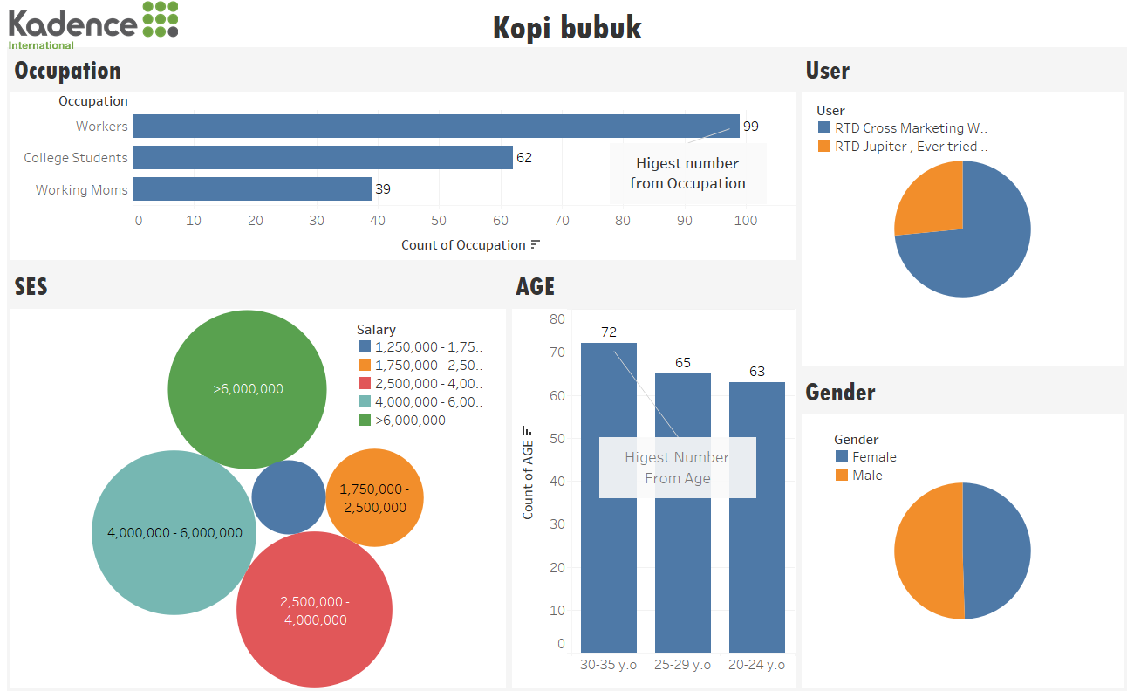
27%
73%
(Persons)
Most user is RTD Cross
Marketing white coffe
55
51%
49%
59
53
Most Gender from male better
than 1% from female

Slide 7
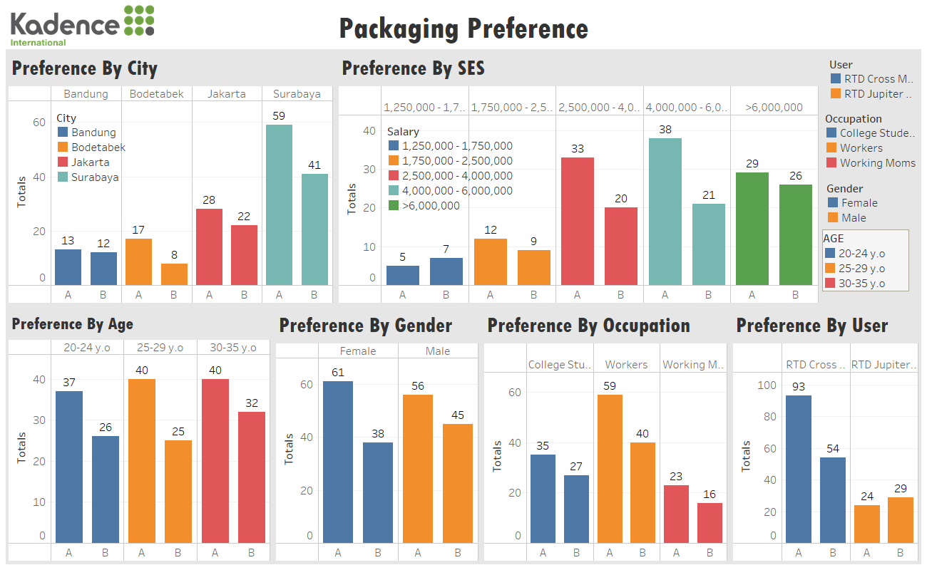

Slide 8
Conclusion
Packagin perefence Type A have a great demand for each group. Start from city, SES,
Gender, Age, Occupation and User. For each data showing a Packagin tipe A always
Superior for each category. Beside of this data I highly recommend to use Packagin Type A
For the Package. Because most people will choose this packaging.

Slide 9

THANK YOU
VERY MUCH

Slide 10

CONTACT ME
YOUR SUBTITLE HERE
DRAMAGA, BOGOR, INDONESIA
+62812131463091
rizkyhalawi@gmail.com

